Slide 1
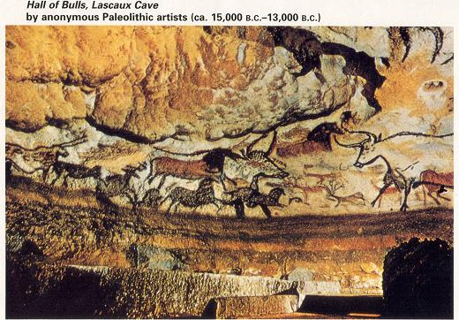
Pre History

Slide 2
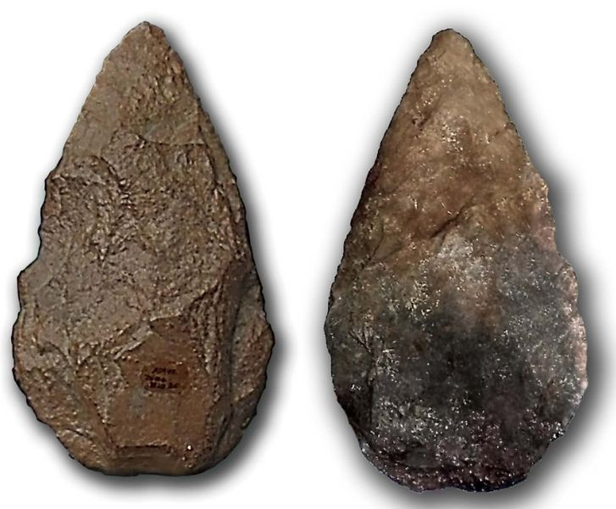
Paleolithic Age

Slide 3
Neolithic Revolution
"The Agricultural Revolution"

Slide 4
THE TEST

Slide 6
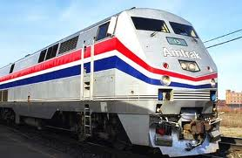
Planes
Cars
Trains
Boats

Slide 7
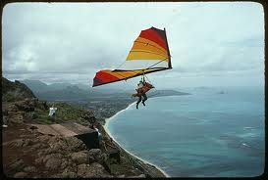
Did he just say hang gliders?...

Slide 8
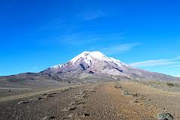
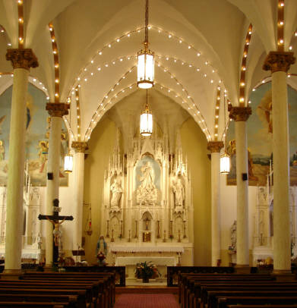
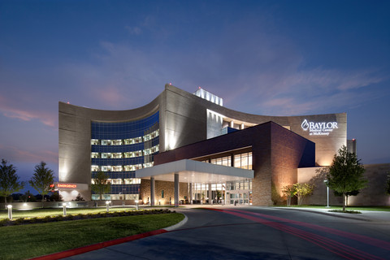
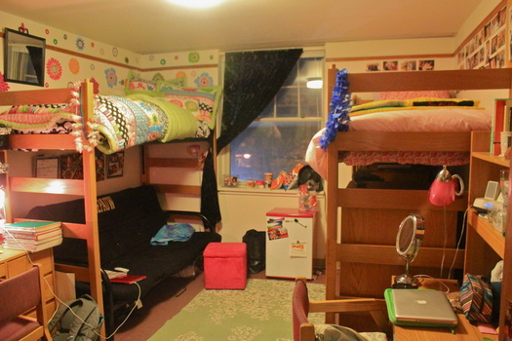
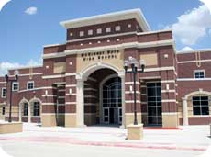
Bars…not yet
Mountains
Worship Places
Hospitals
Offices
Dorm Rooms
Schools

Slide 9
First Dates
Job Interviews
Twitter Feed
Watching Football

Slide 10
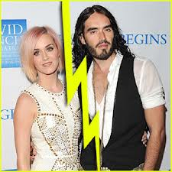
Empty Political Rhetoric
Celebrity Marriages

Slide 11
THE TEST

Slide 13
99¢ Double Cheeseburger

Slide 15
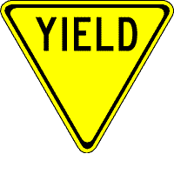
Note Taking 101:
It’s not Rocket Science, It’s not Brain Surgery, …It’s ROCKET SURGERY
Anything in Red is considered important. Write it down!!!
Anything in Yellow is a question. Think about an answer. You will probably need to write this down as well.
Anything in Green is something extra that you might want to include.

Slide 16
Note Taking 101:
Lets PRACTICE!!!
Pre History – the time before written history.
Paleolithic Age – time before invention of farming.
Neolithic Age – time after invention of Farming.
ITS REVOLUTIONAR!!!

Slide 17
People were nomadic and moved from place to place in search of food. They were foragers and hunters.
Foragers – people who gather fruit, nuts, grains, etc. for food.
Hunters – those who hunt meat
People mostly lived next to the sea because of its
A) Abundant food source
B) Relatively unlikely to eat you

Slide 19
skoodlypooping?

Slide 20
What do you think those very first crops were in those places.?
Southeast Asia – ???
Mexico – ???
Andes Mountains – ???
Fertile Crescent – ???
West Africa – ???

Slide 21
What do you think those very first crops were in those places.?
Southeast Asia – Rice
Mexico – Maize (Corn)
Andes Mountains – Potatoes
Fertile Crescent – Grains, Barley
West Africa – Yams

Slide 23
Neolithic Revolution
Since so many communities made this choice independently, it must have been a good choice, right?
What are the advantages and disadvantages?

Slide 24
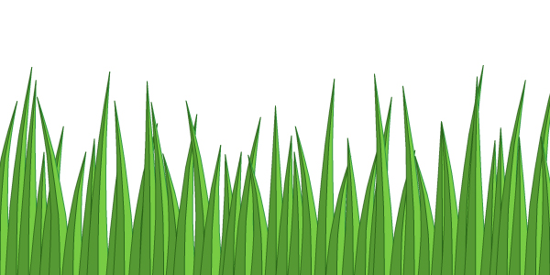
Neolithic Revolution
Advantage:
A) Controllable food supply: you might have drought or floods but if you’re growing the crops and breeding them to be healthier and heartier, you get a bit more say in whether or not you starve.
VERY NICE!!!!!

Slide 25
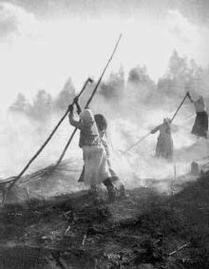
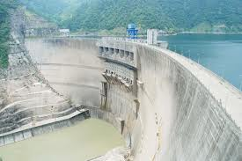
Neolithic Revolution
Disadvantages:
A) Pollution: In order to keep feeding people as population grows, you have to radically change the landscape of the planet. You must control the environment every which way you can.
Pollution & Destruction of Environment

Slide 26
Neolithic Revolution
Disadvantages:
Pollution:
1. Slash and Burn Farming – burn a field to create nutrient soil. Farm for a few years than move on to next field.
Slash and Burn Farming

Slide 27
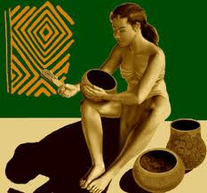
Neolithic Revolution
Advantage:
B) You can create a food surplus, especially if you grow grain, which makes cities possible and also the specialization of labor.

Slide 28
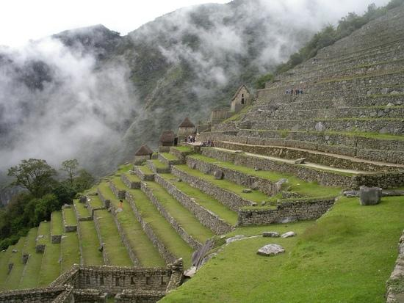
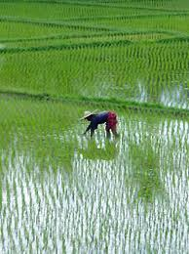
Neolithic Revolution
Advantage:
C) Almost Everywhere: Agriculture can be practiced in many places all over the world, although in some cases and lots of places it requires extensive manipulation of the environment; e.g., irrigation or controlled flooding or terracing.
Terrace Farming
Controlled Flooding

Slide 29
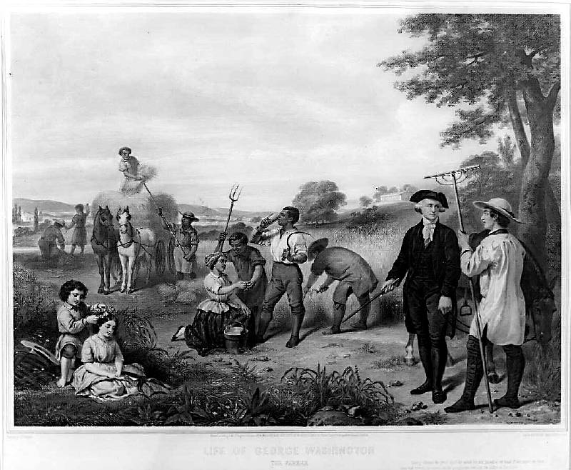
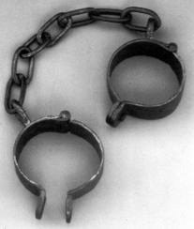
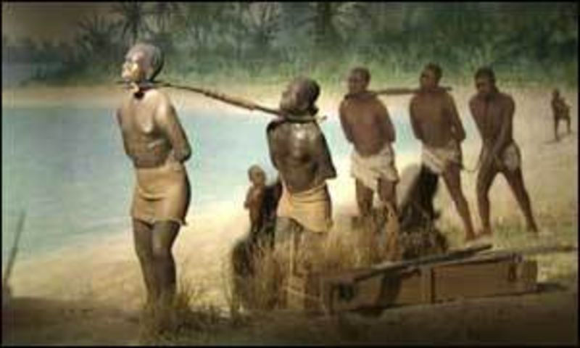
Neolithic Revolution
Disadvantages:
B) Farming is hard: So hard that it has led to slavery.

Slide 30
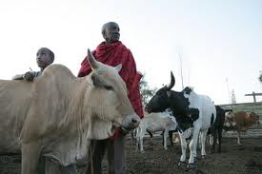
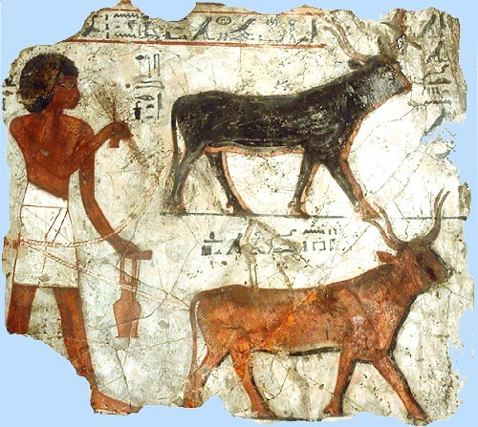
Neolithic Revolution
Herding:
Domestication: taming of animals for your own source of food and shelter.
What are the advantages and disadvantages to herding?

Slide 31
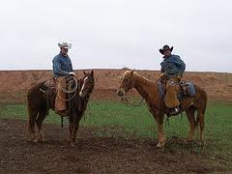
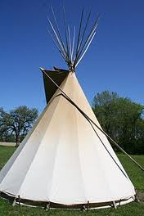
Neolithic Revolution
What are the advantages and disadvantages to herding?
Advantages:
You get to be a cowboy.
Animals provide meat and milk and shelter (wool and leather).
Disadvantages:
1) You have to move around a lot for new pastures.

Slide 32
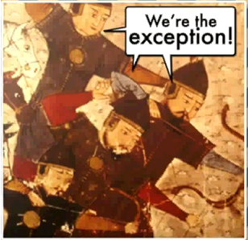
The Mongols:

Slide 33
The Mongols:

Slide 34
Neolithic Revolution
What animals lend themselves to herding?
What do they have in common?
sheep, goats, cattle, pigs, horses, camels, donkeys, reindeer, water buffalo, yaks
None of them live in AMERICA!!!

Slide 35
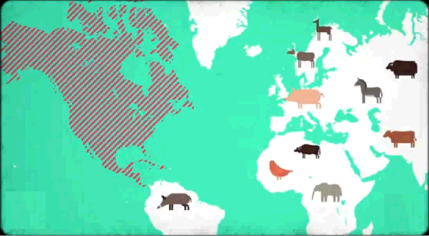

Slide 36
Dalai Lama

Slide 37
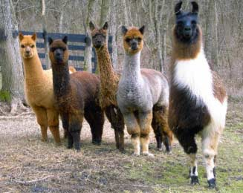
Actual Llamas…

Slide 38
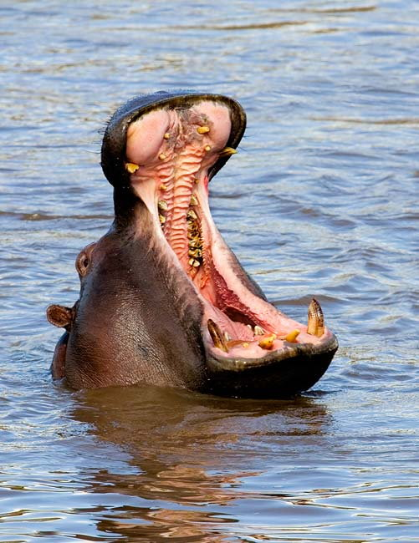
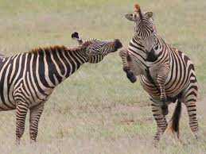
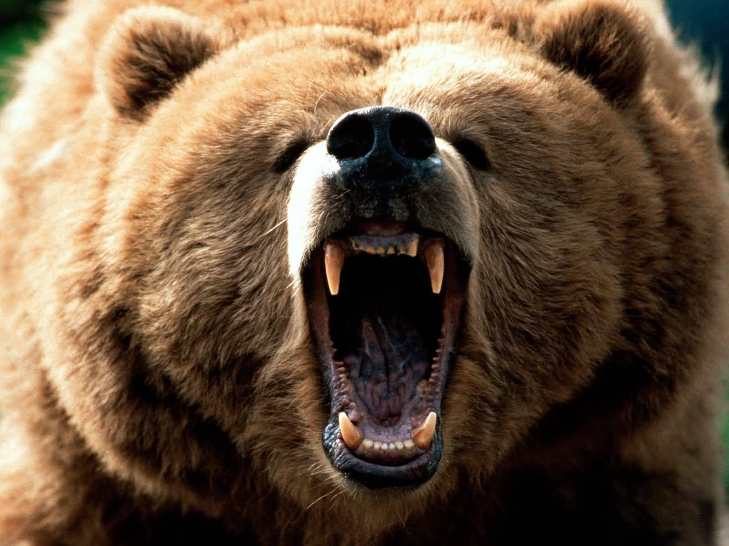
I need a toothbrush!!!

Slide 39
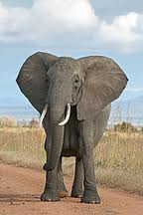
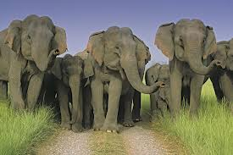
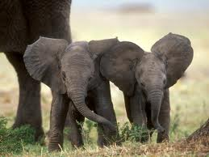
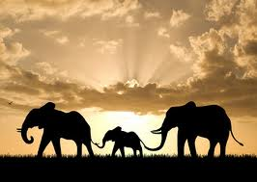

Slide 40
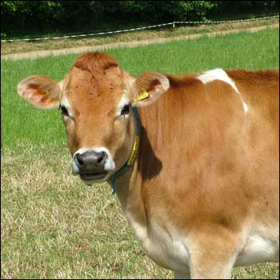
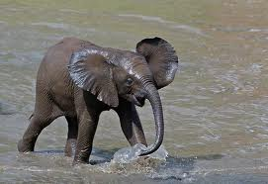
Cow Population
Elephant Population

Slide 41
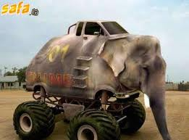
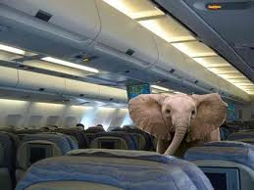

Slide 42
22 month pregnancy

Slide 43
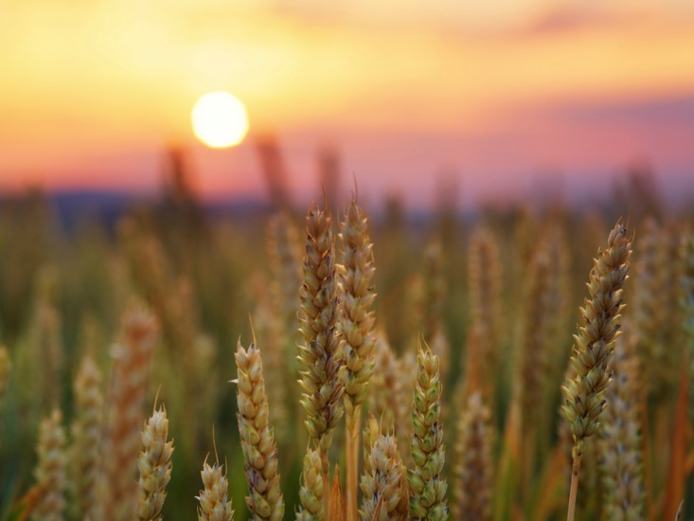
Neolithic Revolution
Imagine that you are a hunter-gatherer. You return to a campsite you were at the previous year. When you arrive, you discover that crops you once searched and collected were growing abundantly in the center of your camping area in the area you once threw out your seeds.
What would you think? How could this change your lifestyle? What would you suggest to your group that you do?

Slide 44
Neolithic Revolution
What was the role of women
during the Neolithic Age?
Did they invent agriculture?

Slide 45
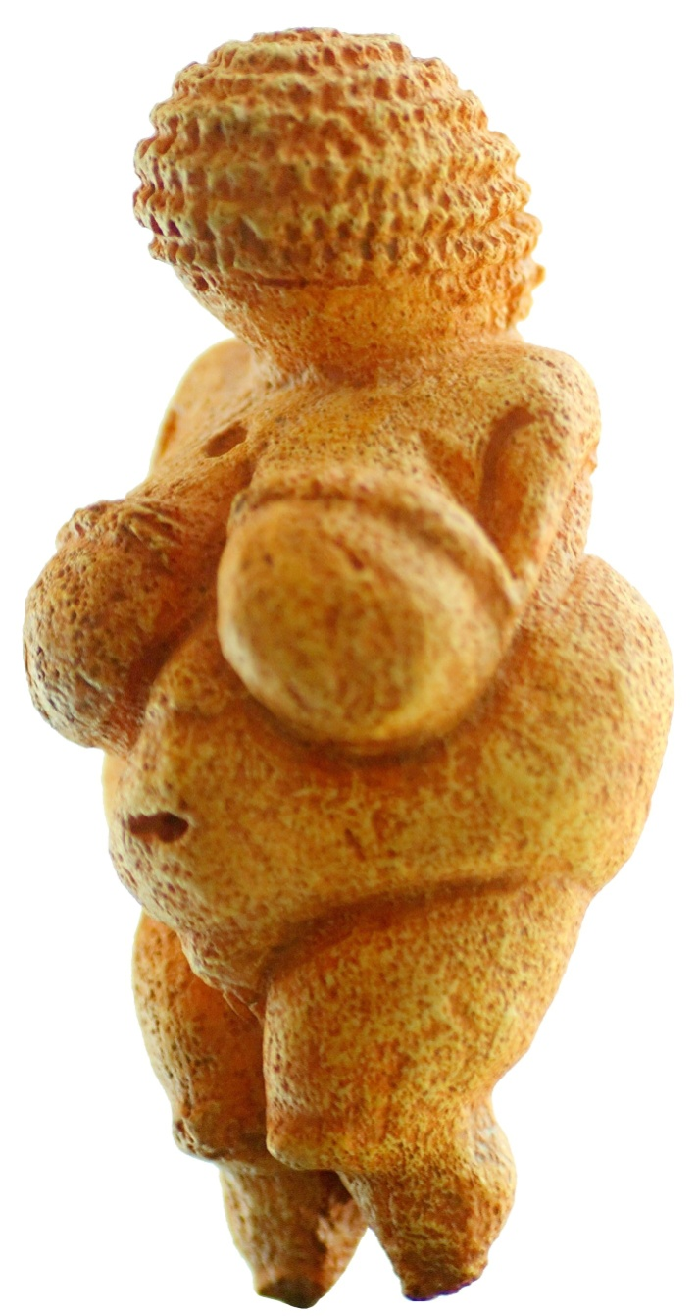
Venus de Willendorf
What does this piece tell us about the views of early civilizations? How?

Slide 47
Neolithic Revolution
Matriarchal Societies
Matriarchal Society – female dominant society.
Early civilizations centered around the women.
The women were the originators of agricultural and the villages depended on them.
Venus of Willendorf is the oldest piece of art discovered.

Slide 48
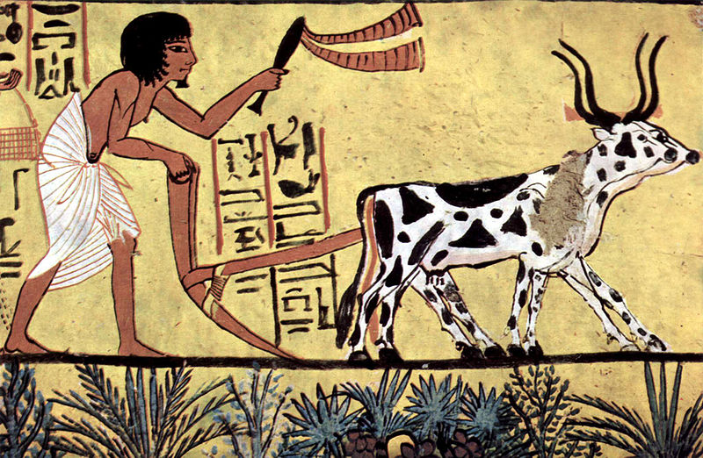
Neolithic Revolution
Patriarchal Societies
As civilizations formed and grew, women’s roles diminished.
The value of agricultural labor and protection of land greatly increased.
Patriarchal Society – male dominated society.
Who would this benefit most? Why?

Slide 49
Neolithic Revolution
Why did the Agricultural Revolution occur?
Historians don’t know why for sure because we don’t have written records, but historians love to make guesses:
What do you think happened?

Slide 50
Neolithic Revolution
Why did the Agricultural Revolution occur?
Maybe population pressure necessitated agriculture even though it was more work.
Abundance gave people leisure time to experiment with domestication.
Planting originated as a fertility rite for women.
Or as some historians have argued – people needed to domesticate grains in order to produce more alcohol.

Slide 51
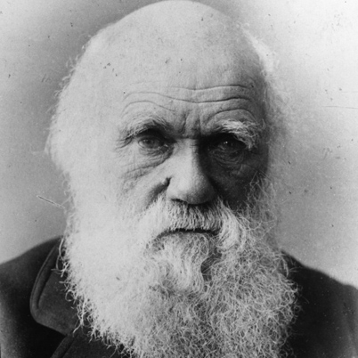
“A wild and unusually good variety of native plant might attract the attention of some wise old savage.”
-- Charles Darwin

Slide 52
Neolithic Revolution
Why did the Agricultural Revolution occur?
5. We’re Just Hungry: Maybe the best theory is that there wasn’t really an agricultural revolution at all but that agricultural came out of or was a part of an evolutionary desire to produce more to eat. After all, hunter gatherers know that seeds germinate and if climate permits knew how to grow crops. So when you find something that’s edible, you try to get more of it. Ifs, while otherwise preferring not to forage (since it’s less work, after all).

Slide 53
Neolithic Revolution
Conclusion:
Would we un-do agriculture?

